Slide 1
Drug therapy in hepatic impairment
Medbase Ltd

Slide 2
Liver diseases relevant for pharmacokinetics
Chirrosis
Alcohol liver disease
Viral hepatitis B ja C
Primary biliary chirrosis & sclerosing cholangitis
Prevalence 200-300/100.000 inhabitants in Europe (J Hepatol 2013;58:593-608.)
Clearly the most important liver condition affecting pharmacokinetics of drugs
Liver toxicity caused by drugs, natural products and mushrooms
Paracetamol + other NSAIDs
Chapparal (Larrea tridentata), Amanita virosa -mushroom

Slide 3
Hepatic impairment and ADRs
Eur J Clin Pharmacol. 2013;69:1565-73.
Retrospective chart study in 400 patients with cirrhosis at hospital admission (Child-Pugh: A 18%; B 39%; C 43%)
Altogether 1653 prescriptions (0-15 / patient)
Every fifth (336) prescription with an error (184 patients)
36 contraindicated; 300 too high dose (no adjustment)
69 adverse events related to non-adjustment of the dose in relation to the hepatic function
68% preventable
Flaws in prescribing led to 94 extra in-hospital days
Problem drugs:
NSAIDs (g-i bleeding), hypnotics and other benzodiazepines,
PPIs (peritonitis)

Slide 4
Determining the liver function with regard to drug therapy
Laboratory testing:
Serum albumin (proteins) and INR (pro thromin time) are the best indicators for the drug metabolic function
Transaminases do not mirror drug metabolic capacity of the liver
Child-Pugh(-Turcotte) classification:
Bil, Alb, INR, Ascites, Encephalopathy
The most used method, e.g. EMA and FDA
Originally not developed for drug dosing, but for patient evaluation before shunt surgery (in chirrosis)
Not equally accurate as e.g. GFR in renal failure

Slide 5
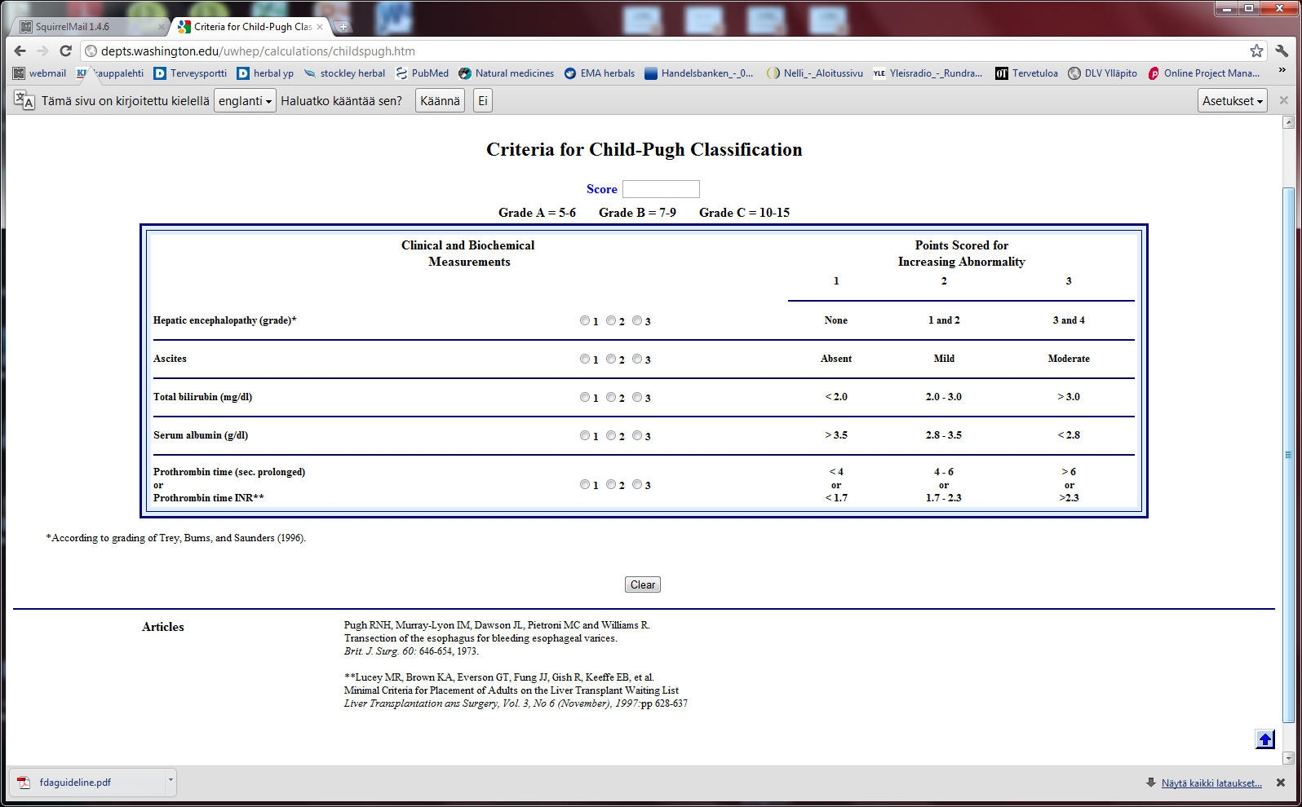
Stages of Ascites:
Stage 1: No ascites
Stage 2: Mild (responds to treatment)
Stage 3: Severe (does not respond to treatment)
Stages of Hepatic Encephalopathy
Stage 1: Euphoria or depression, mild confusion, slurred speed, disordered sleep
Stage 2: Lethargy, moderate confusion
Stage 3: Marked confusion, incoherent speech, sleeping but arousable
Stage 4: Coma, initially responsive to noxious stimuli, but later unresponsive

Slide 6
classification
Degree of hepatic impairment, based on Child-Pugh classification, is divided into three categories, according to the classification by EMA and FDA:
A Child-Pugh 5-6 (mild hepatic impairment)
B Child-Pugh 7-9 (moderate hepatic impairment)
C Child-Pugh >10 (severe hepatic impairment)
The safety and need for dosage recommendations is classified into four different categories (A to D), clarified by a colour coding system:
No need for dosage modification
The information is not available or the recommendation is estimated based on the pharmacokinetic characteristics of the substance
Modification of the dose or dosage interval is needed
The use should be avoided
For categories B and C, a detailled numerical information on the magnitude of dosage modification is provided whenever available.
A
B
C
D

Slide 7
FDA guideline in drug development
Studies in hepatic impairment need to be performed before marketing authorisation:
When the liver metabolism / excretion (to bile) accounts for >20% of the total clearance of the drug
Always when the therapeutic index of the drug is small
No need to do the studies when:
Drug is given as single dose (no risk of accumulation)
the liver metabolism / excretion (to bile) accounts for <20% of the total clearance of the drug
Inhaled medical gases, which are eliminated in exhalation

Slide 8
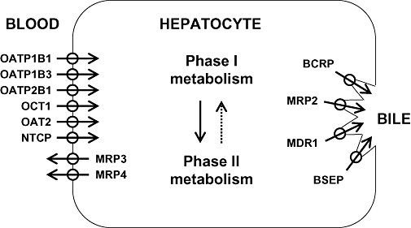
The function of the hepatocyte is regulated by: 1. multiple transporter proteins that transport the drug to the hepatocyte 2. drug metabolic enzymes 3. multiple transporter proteins that transport the drug/metabolite(s) from the hepatocyte
Cholestasis
-phenthiazines
-anab. steroids
-erythromycin

Slide 9
How does reduced liver function affect drug metabolism?
CYP-enzymes are most sensitive
Reduced number of hepatocytes low enzyme activity
CYP2C19 most sensitive (effect seen in Child-Pugh A,B,C)
Then CYP2D6 and 1A2 (effect seen in Child-Pugh B &C)
Drugs with high first pass effect (tizanidine, agomelatiini) – up to 100-fold increased exposure in hepatic impairment
Pro drugs (tamoxyfen (!!), codeine, proguanil etc.) are not activated
Conjugation reactions have larger reserve and are less affected (Child-Pugh C; e.g. lorazepam or oxazepam)

Slide 10
How does reduced liver function affect drug metabolism?
Liver blood flow:
In chirrosis shunting causes that blood flow by-passes the liver
By-pass of first-pass metabolism can cause drastic increase in drug exposure after p.o. dosing
tizanidine, agomelatin, statins
Excretion to the bile (cholestasis)
Intrahepatic (common in chirrosis) – reduced excretion (e.g. telmisartan)
Extrahepatic –very little information available
Reduced binding to plasma albumin
Very drug-specific – some drugs are affected, most are not

Slide 11
Hepatorenal syndrome
Rapidly (2 weeks) or slowly progrediating forms
General mechanism: reduced systemic arterial resistance due to portal hypertension which cannot compensated by increased cardiac minute volume → hypoperfusion of kidneys, reduced GFR, activation of RAAS + other vasoconstrictive compensatory mechanisms
In severe hepatic impairment drugs inhibiting RAAS can have drastic hypotensive effect
Common when the liver diease is associated with ascites, uncommon when there is no ascites (Child-Pugh C)
In chirrotic patients cystatiini C –based eGFR may be more accurate than one based on serum creatinine
Creatinine synthesis is reduced in chirrosis, partly due to reduced muscle mass
eGFR should be estimated by CKD-EPI or MDRD
Significant source of bias in pharmacokinetic studies in severe hepatic impairment (Child-Pugh C)

Slide 12
Case bisoprolol
Total clearance
Compensation
50% renal clearance
50% metabolic clearance
Total clearance little/
not affected

Slide 13
Case bisoprolol
Total clearance
compensation
50% renal clearance
50% metabolic clearance
Total clearance little/
not affected

Slide 14
Case bisoprolol
Total clearance
compensation
50% renal clearance
50% metabolic clearance
Total clearance drastically dropped
Cannot be controlled by dose adjustment

Slide 15
Peculiar behavior of propranolol in hepatic impairment
Metabolized 95% in the liver (CYP1A2/2C19/2D6)
Has an active metabolite
Low oral F (25%); binds 90% to plasma proteins
Exposure 3-7 –fold in hepatic impairment, but no correlation to the severity (as assessed by Child-Pugh)
p= n.s.
No difference in the
hemodynamic effect
between the groups
START LOW (20 mg/day) and GO SLOW

Slide 16
Altrered pharmacodynamics in hepatic impairment
Reduced drug effect
Beta-blockers
Diuretics
Loop-diuretics, triamteren
Increased drug effect
Drugs inhibitng the RAAS
Hepatorenal syndrome
Opioidit
Exacerpation of enkephalopathy
Sedative psychleptics
benzodiazepines and other GABA-ergic drugs, CNS H1-receptor blockade

Slide 17
Drug induced liver disease (DILI)
Described as a rare / very rare ADR in almost 1000 different drugs (e.g. statinis)
Hepatocyte damage (increased transaminase values)
Acute drug-induced hepatitis (NSAIDs)
Cholestatic damage (Bil, Afos)
Inflammatory reaction (hepatis) or not (estrogens, androgens, chlorpromazine)
Ciclosporin, atorvastatin
Almost always type B ADR – cannot be prevented by decreasing the dose
Predisposing factors
Earlier DILI, alcohol consumption
Liver or kidney disease
Drugs known to be hepatotoxic should not be used in chirrotic patients
Pregnancy, drastic weight loss, age >60 years
Well known hepatotoxic drugs
Methotrexate, paracetamol, amiodarone – toxicity is dose-dependent

Slide 18
Ideas for functionality of portal
Child-Pugh – calculator needed for determining the degree of hepatic impairment
Search functionality with both generic and trade names
Possibility to see the whole drug (ATC) group at one glance to find the best alternative
Severe hepatic impairment is often associated with reduced kidney function:
Inter-functionality between heparbase and renbase
Warning to check also renal function when the patient’s Child-Pugh score is >9 and there are dosage modification recommendations in renbase
Link to drug’s renbase article

Slide 19
Advice for drug dosing in hepatic impairment
There are great differences between drugs even within a given therapeutic group in:
Need for dosage adjustment (kinetics, differences in metabolism)
Documentation of the need of dosage adjustment
Risk of hepatotoxicity and other tolarability issues
Studies and medical evidence are based onChild-Pugh –clasification and by use of Child-Pugh –calculator a reliable dosing adjustment can be made from heparbase
Sometimes dosing can be eased by alternative choice of dosage form, e.g. changing p.o. dosing to suppository, transdermal or parenteral dosage form by-passing the first-pass metabolism

Slide 20
Advice for drug dosing in hepatic impairment
Avoid pro-drugs (reduced/abolished efficacy)
Reduced GFR associated with severe hepatic impairment is a therapeutic challenge
eGFR should be calculated and aim to select a drug which is not a risk drug in hepatorenal syndrome (risk drugs are pointed out in the additional information text of heparbase)
Recommendations on dose adjustments are based on the isolated effect of hepatic impairment on drug exposure
the initial dose (where the %-reduction is made from) is the dose that you would give to the patient if he had a normal liver function

